Slide 1
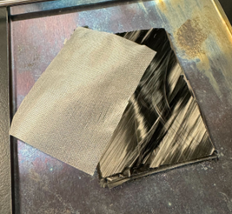
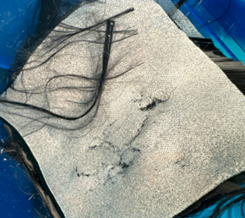
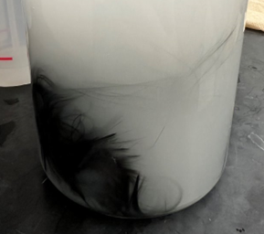
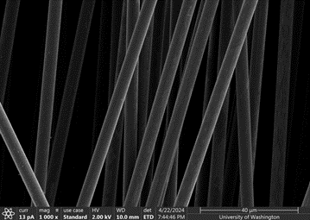
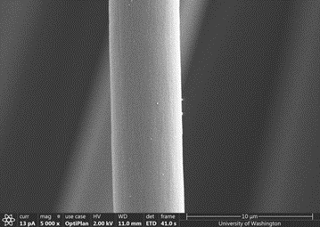
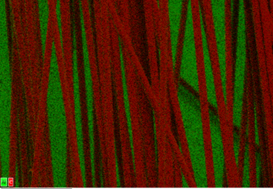
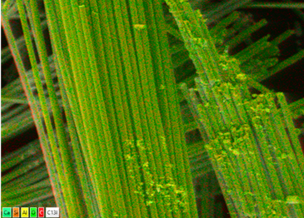
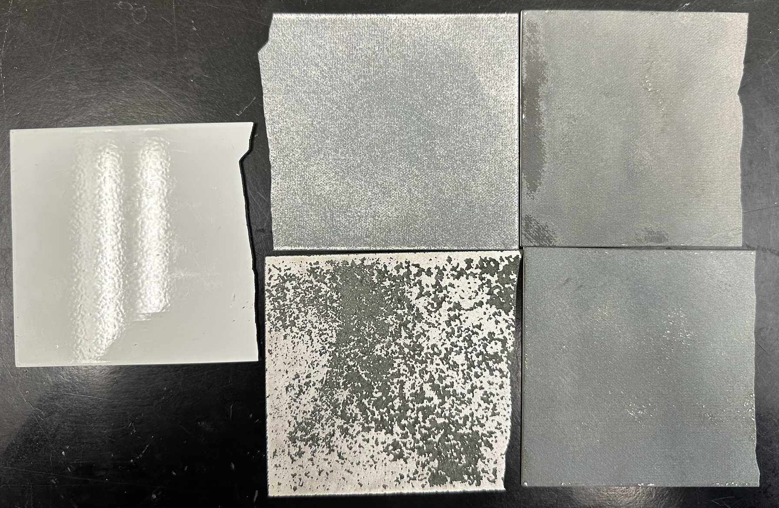
Surface Layer Removal of End-of-Life Carbon Fiber Composites
Lia Crawford, Kathy Do, Megan Wong, Oliver Wolf Faculty Mentor: Dr. Benjamin Rutz | Boeing Mentors: Karly McCauley, Pete George, Isabella DiGiulio
BACKGROUND
METHODS
a)
b)
Composites such as carbon fiber reinforced plastics (CFRP) are increasingly replacing metals as structural components of airplanes due to their strength and durability. In the Boeing 787, composites account for approximately 50% of the aircraft’s weight, minimizing fuel consumption [1]. However, 6,000+ commercial aircraft are projected to be retired by 2030 [2].
Pyrolysis is a recycling method where CFRPs are heated to >450°C to burn off the epoxy that holds the carbon fibers together. Pyrolysis is used on factory scrap, but it is unknown how coatings might impact this process. Coatings on end-of-life parts include a polyurethane paint/primer and copper (lightning strike protection), and there is a fiberglass layer in the CFRP that needs to be removed.
Pyrolysis
Thermogravimetric Analysis (TGA)
Sanding
Media blasting (Fig. 3)
Walnut shells
Investigate effects of hold time under air
Post-Pyrolysis Coating Separation
Colloidal suspension (Fig. 4)
Investigate composite degradation to determine pyrolysis conditions
Coating Removal
Aluminum oxide
Coating removed samples
Figure 4. a) Images of the pyrolyzed coupons of 0% and 100% (left to right) removal via media blasting. b) Colloidal suspension to remove paint residue on post-pyrolysis sample.
Nitrogen
Air
CONCLUSION
Figure 1. Overall project flow and methods used throughout winter and spring quarters.
Our experiments suggest that the presence of paint surface layers on the composites during pyrolysis does not result in noticeable damage to the carbon fibers. Coating removal methods before pyrolysis cost more and generally results in additional contaminants or damage that would be undesirable in recycling. Paint residue remaining post-pyrolysis can be removed through colloidal suspension methods.
Future Recommended Work Includes:
Testing pyrolysis and paint residue removal at larger scales
Performing tensile strength testing on fibers to quantitatively validate conclusions
Testing surface effects on solvolysis
Investigating carbon fiber realignment strategies for composite reconstruction
> The flow of our project is depicted in Figure 1.
> Pyrolysis was first run on unaltered samples to select an optimal hold time of 120 minutes under air for all future samples (Fig. 2).
> Samples run under TGA and pyrolysis were analyzed via Scanning Electron Microscopy (SEM) and Energy Dispersive X-ray Spectroscopy (EDS).
550
Temperature (ºC)
500
0
~15
35
40
160
Time (minutes)
Figure 2. Pyrolysis run conditions
> Post-pyrolysis samples had paint residue removed via colloidal suspension (Fig. 4).
RESULTS
> SEM images showed approximately equal amounts of spotting/degradation in carbon fibers across all treatments.
> From SEM/EDS results, removal of coatings via media blasting introduced trace foreign elements and damages the fiberglass layer (Fig. 5).
a)
Proposed Solution
Run samples with differing levels of coating removal through pyrolysis to understand how coatings might affect the breakdown of the epoxy resin and carbon fibers.
b)
Objectives
ACKNOWLEDGEMENTS
Determine if presence of coatings influences pyrolysis outcomes of end-of-life parts
Investigate methods for removing post-pyrolysis coating residue
We would like to thank our faculty mentor Dr. Benjamin Rutz and Boeing technical mentors Karly McCauley, Pete George, and Isabella DiGiulio. We would also like to thank Ben Hornburg, UW Chemical Engineering Facilities Manager, and Scott Braswell, UW Molecular Analysis Facility Staff Scientist.
Figure 3. Media Blasted Samples. From left to right in columns: 0%, 42%, and 100% removal.
Figure 5. a) SEM of 0% (left) and 42% (right) removal of coatings via media blasting. b) EDS of carbon fibers of 0% (left) and fiberglass weave of 42% (right) via removal media blasting.
[1] Slayton R,et. al. Technovation. 2016.
[2] J. Zhang, et. al Composites Part B: Engineering, 2020.

